Slide 1
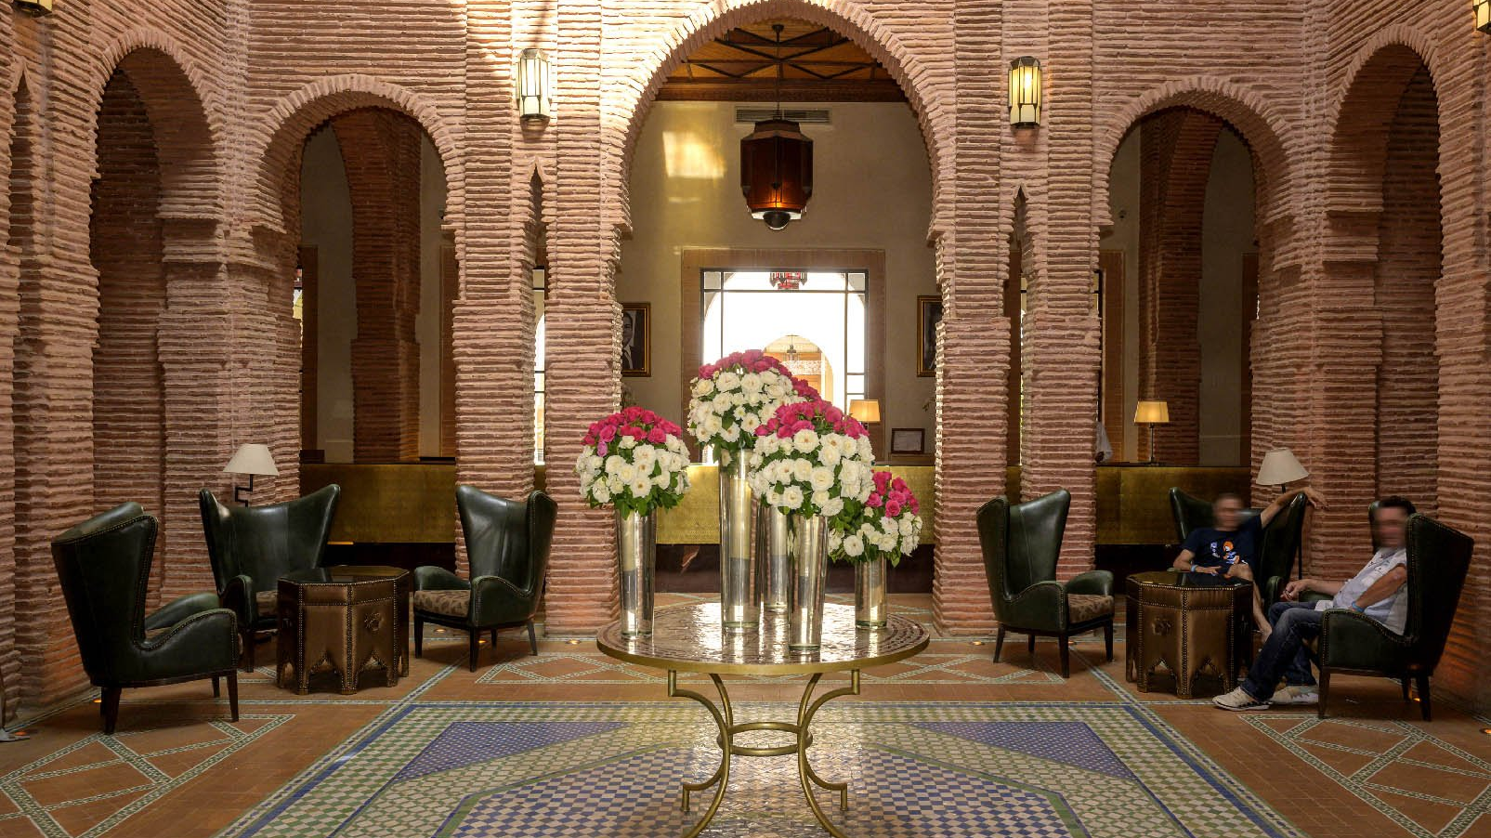

Slide 2
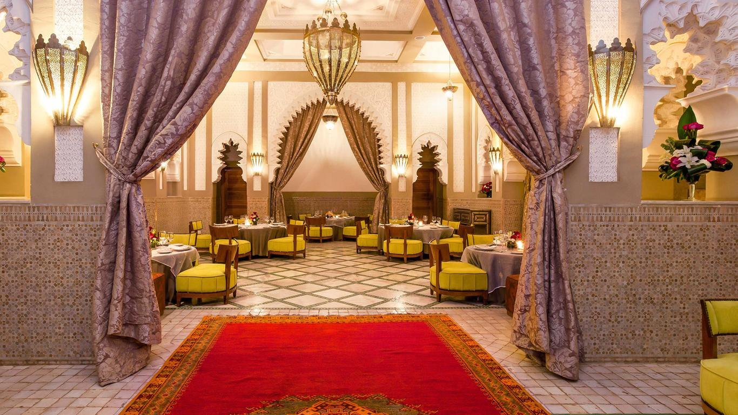
JAAL, an inspiration, a tribute to the travels (Jaoula) of a rich generation of artists and creators, from Mohamed Benbrahim to Hassan Hajjaj, from Winston Churchill to Yves SaintLaurent (Ajyale).
Marrakech is plural, African waves vibrate in it for centuries in an ochre city full of permanent creativity.
It is the effervescence as well as the hospitality of the foundouks of before, places of sharing that JAAL has been able to capture, a concept where Riad and Resort today invites to a real experience in the ochre city.
Inspired by the traditions of the country and the charm of the continent, JAAL, the Riad Resort invites you in the heart of Marrakech in an intimate universe nestled in a vegetable setting hence its initials: J for gardens, local jewels, A for Africa, a jewel in short, folded by an A for lovers of art and culture and finally, L for freedom, lightness and letting go. J A AL, The Riad Resort is all at once!
258 ROOMS

Slide 3
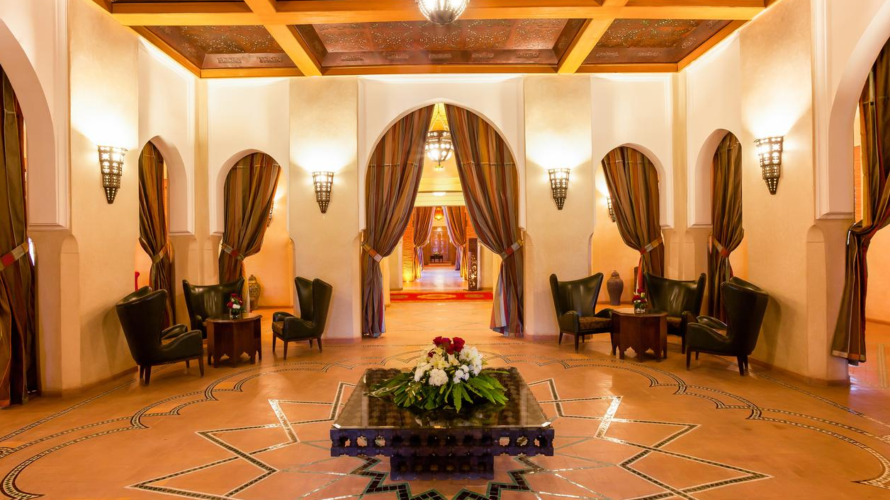

Slide 4
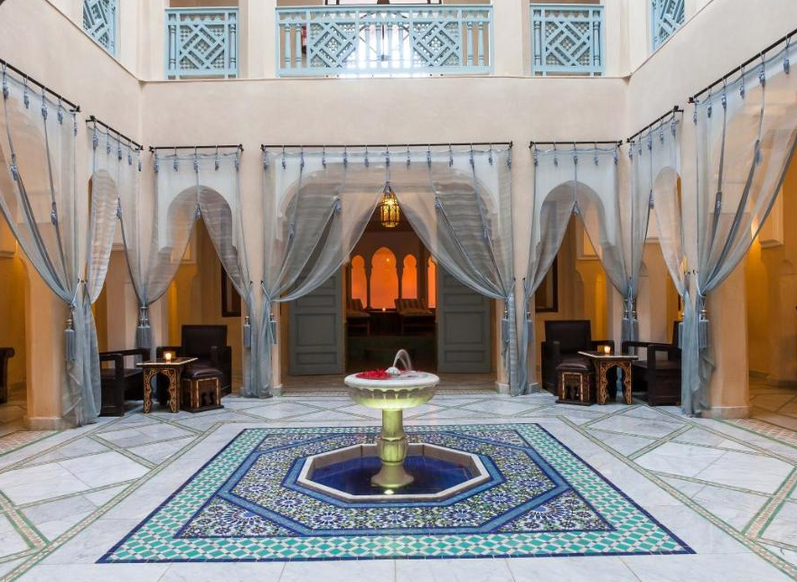
You will stay in a refined room listed in the purest oriental tradition, a bathroom with zelliges made by hand, separated from the WC and open in moucharabieh in the living space.
A sofa corner for your relaxing moments, Netflix and many other features on your 55-inch interactive flat-screen Smart TV doesn’t miss your favorite movies and series. Comfortable to the end, we offer bathrobes, slippers and an anthology of beauty products formulated from essential oils and organic plant extracts signed Botanika.
La Suite Exclusive Riad ILIANA 290 m2
2 Suites Prestige IGNA & Alili 176 m
Les Suites Feel Riad Senior Ayur et Iblili 90m2
Les Suites Feel Riad Junior Azirt et Amlal 94m2
Les Suites Premium Afouk & Keren 104 m2

Slide 5
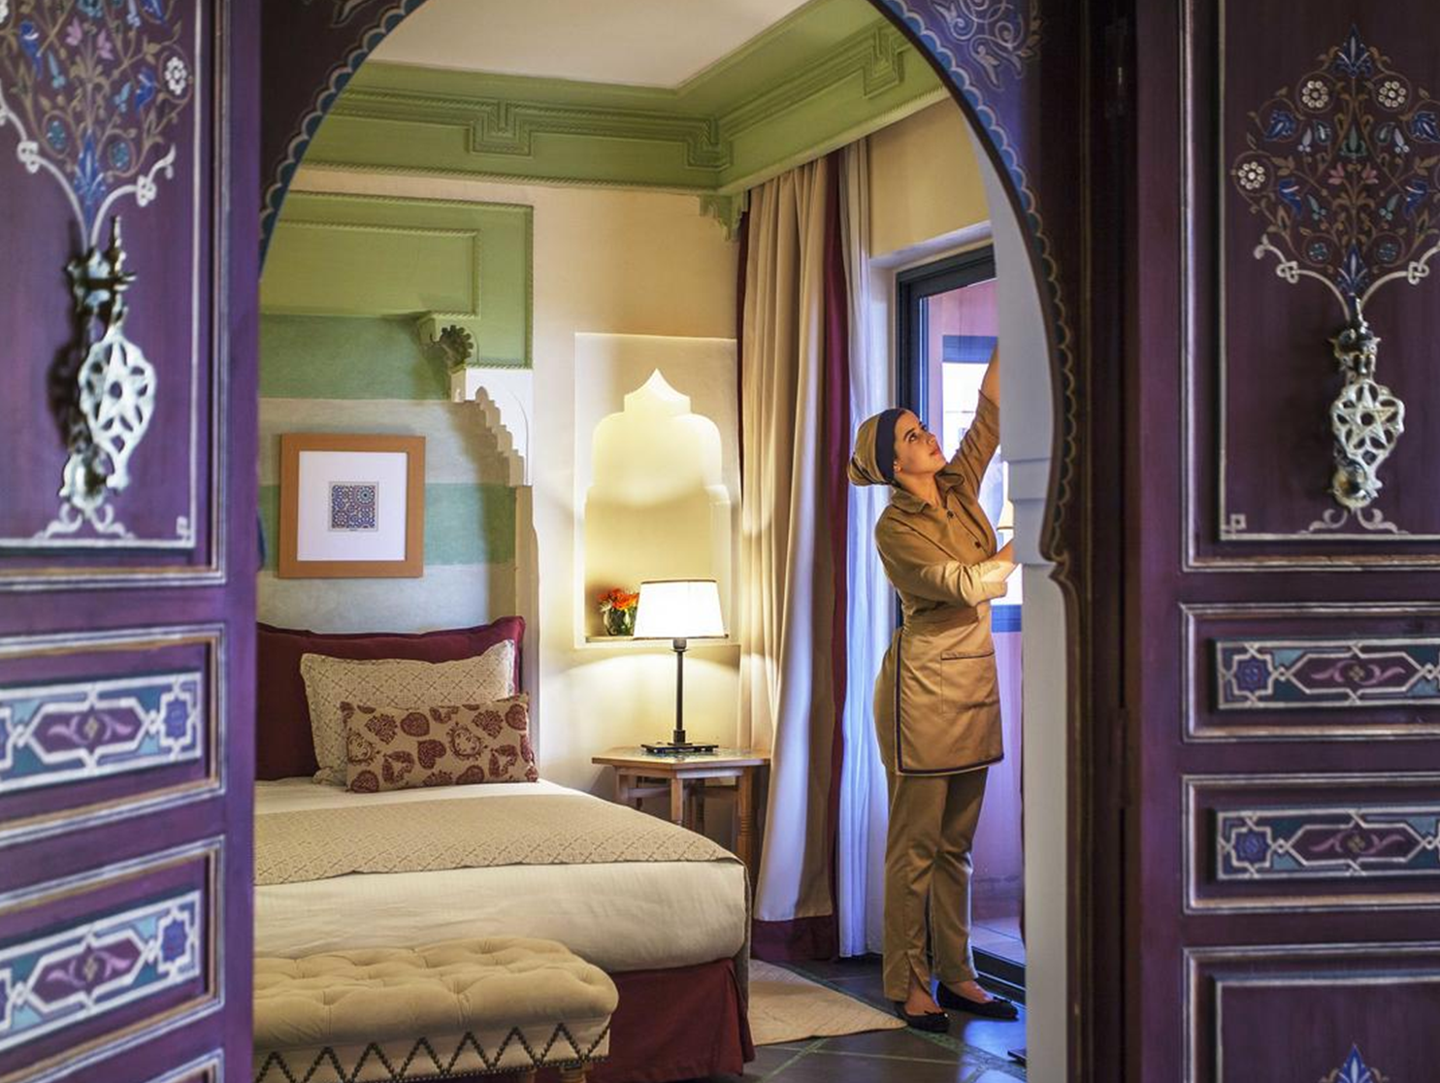
It has elegant rooms and suites that offer the visitor an exceptional calm with the refinement of the Belle Epoque and the purest Moroccan style. All rooms have air conditioning, safe, minibar and full WC.
258 ROOMS

Slide 6
The new generation restaurant of the Riad invites you to an exceptional breakfast, with pastry shop, cold cuts, cheeses or a show cooking eggs, to delight all your desires. In the evening, the Atelier transformed into a world tour flavors offering food inspired by Thai, Peruvian, Indian, Lebanese...
The pool bar and restaurant, open in the gardens of JAAL, you welcome every day from 12:30 to 6pm to offer a fresh, summer, light menu... A sea bass ceviche accompanied by a passion fruit sauce, a real Caesar salad, the fashionable Smash Burger or a mustard coquelet... The O2 map promises pleasant surprises.
A must-see and a must-see nestled around the neck of the Riad and open to the beautiful courtyard, the TERRAZ invites you to discover a creative and tasty fusion cuisine, such as the crunchy samosas, a pôélée of Scallops with asparagus and artichokes, or a tagine from Generoso San Pedro, and finish in a gourmet touch with the mythical soft chocolate raspberry heart!
A must-see and a must-see nestled around the neck of the Riad and open to the beautiful courtyard, the TERRAZ invites you to discover a creative and tasty fusion cuisine, such as the crunchy samosas, a pôélée of Scallops with asparagus and artichokes, or a tagine from Generoso San Pedro, and finish in a gourmet touch with the mythical soft chocolate raspberry heart!
A parade of modern oriental flavors. The lounge restaurant comes alive in the evening to offer you a festive atmosphere.

Slide 7
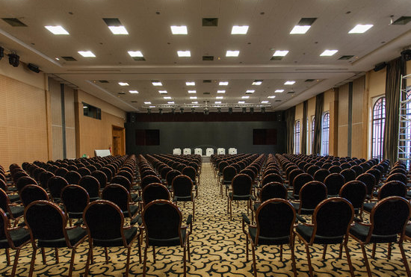
Our rooms are studios, places to share, highlight employees, create value and enjoy many experiential coffee breaks in rooms, rooftop or poolside.
To Meet puts at your disposal many partners able to schedule your meeting. IZZA, our ballroom with capacity for 650 people, modular in plenary.

Slide 8
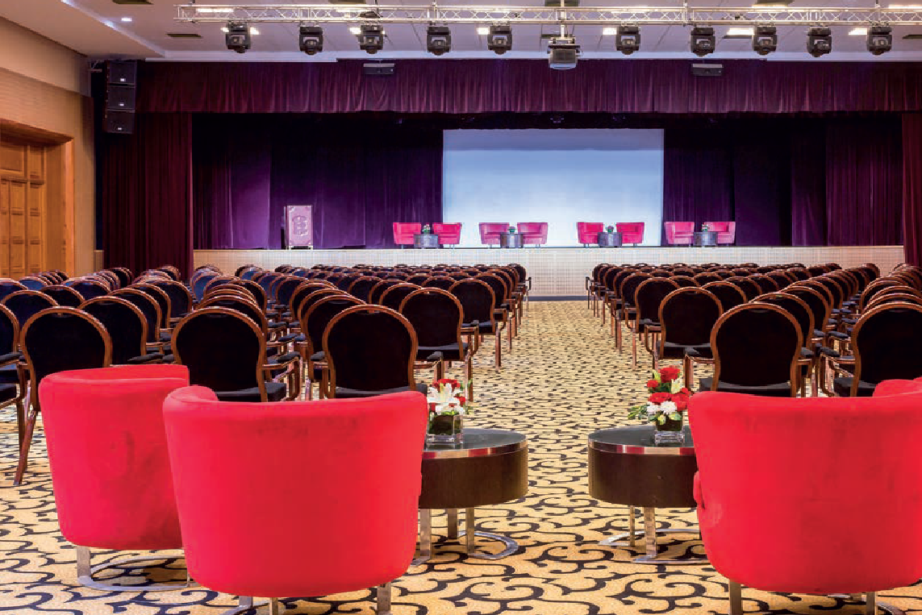
Capacity:
650 pers. in theatrical edition
350 pers. in class assembly
80 pers. in assembly
450 pers. in banquet assembly
550 pers. in cocktails assembly.

Slide 9
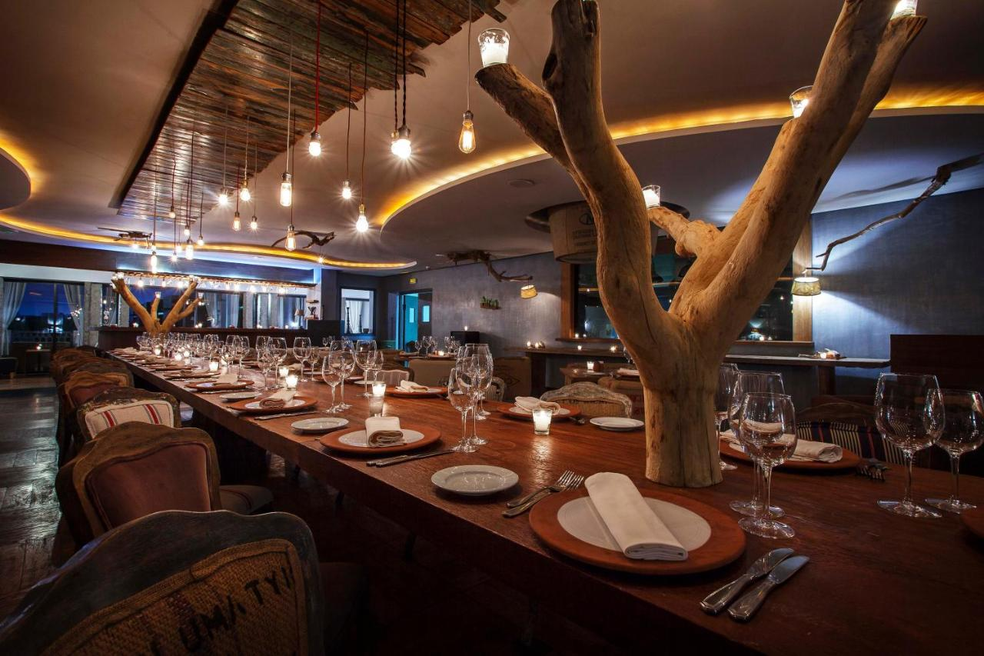

Slide 10
Subcommittee Studio 1
Surface (140m2)
Capacity:
140 pers. in theatrical edition
100 pers. in class assembly
45 pers. in assembly U
130 pers. in cocktails assembly.
Studio de sous - commission 4 Surface area (42M2)
Capacity:
40 pers. in theatrical edition
32 pers. in class assembly
20 pers. in U-mount
35 pers. in cocktail assembly.
Studio de sous - commission 2 Surface (87M2)
Capacity:
90 pers. in theatrical edition
60 pers. in class assembly
25 pers. in U assembly
35 pers. in cocktail assembly..
Studio de sous - commission 30 Surface (42M2)
Capacity :
40 pers. en montage théâtre
32 pers. en montage clase
20 pers. en montage U
35 pers. in cocktail montage.

Slide 11
